Slide 1

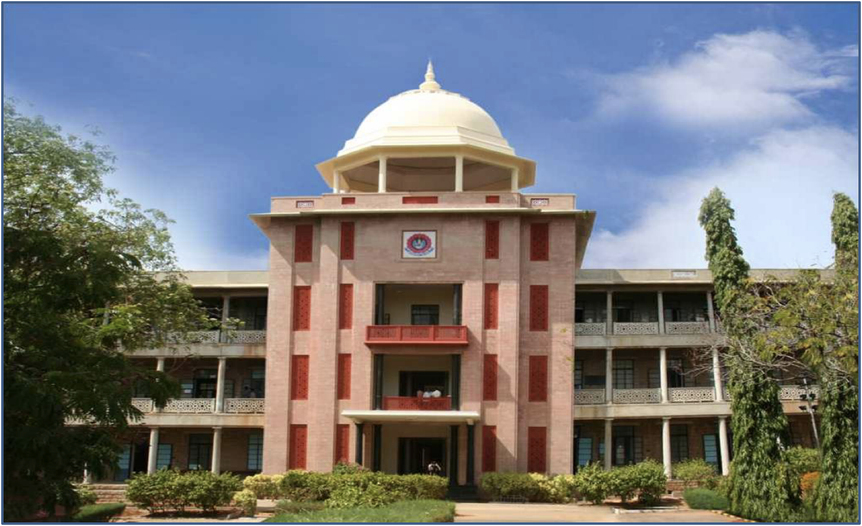
IoT BASED PRODUCT RECOMMENDATION SYSTEM USING MACHINE LEARNING
THIAGARAJAR COLLEGE OF ENGINEERING, MADURAI-15
(A Govt. Aided Autonomous Institution affiliated to Anna University)
- where quality and ethics matter
GUIDE :
Dr. C. Sridharan
TEAM MEMBERS :
Nitin Vinayak S (19C062)
Rajarajesvarri G (19C077)
10/03/2023
Computer Science and Engineering

Slide 2
Objectives
To automate the billing process instead of waiting for long queues at stores.
To recommend a particular product and all of it’s related products based on the availability of current stocks and arrival of new stocks.
To manage the stocks better by collecting the necessary information such as the goods sold, available goods and to recommend the frequently sold products and their related products.
To implement better marketing strategies, to increase the sales of goods and services and make the business profitable.
10/03/2023
Department of Computer Science and Engineering

Slide 3
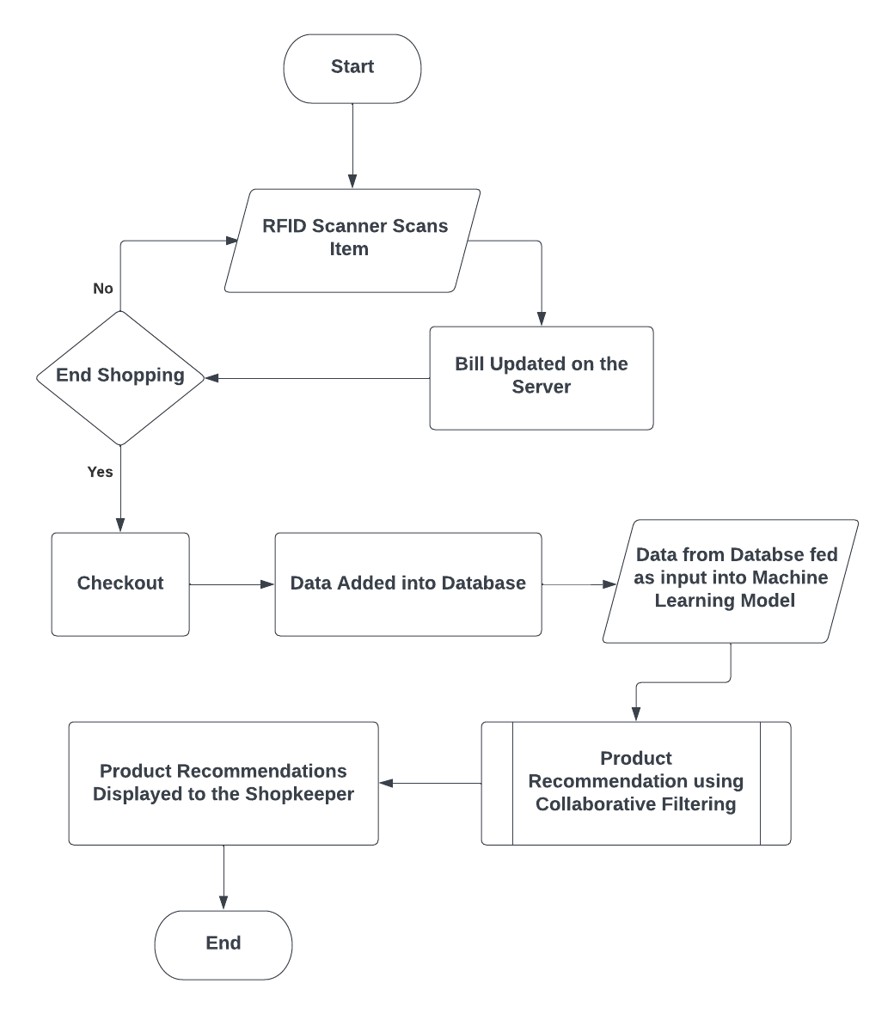
Design of the System
10/03/2023
Department of Computer Science and Engineering

Slide 4
Contributions
Nitin Vinayak S | Rajarajesvarri G
Collected Dataset to Train the Machine Learning Model & Testing the Model | Code for the Machine Learning Model
Display the Machine Learning Model's output in a website using Flask | Integration of Hardware Components
Research Paper | Research Paper
10/03/2023
Department of Computer Science and Engineering

Slide 5
Results & Discussions
Collection of Dataset using RFID
The dataset for the construction of the the Machine Learning Model has been collected.
Built Machine Learning Model (i.e Product Recommendation Engine)
The model has been successfully run using a sample dataset. The model is being constructed for our dataset.
Integration of Python Flask
In-order to display the list of recommended products in the web-app a flask module has been used.
10/03/2023
Department of Computer Science and Engineering

Slide 6
Action Plan
for Completion of the Project
Works | Description | Start date | End date | Status
Domain and Sub-Domain | Selecting Domain(IoT) and Sub-Domain(ML) | Jan 4th, 2023 | Jan 8th 2023 | Completed
Literature Survey | Studied IEEE, Springer, Wiley, Tech Science Press journals | Jan 9th ,2023 | Jan 15th ,2023 | Completed
Problem Statement | Formulation of the problem Statement | Jan 16th ,2023 | Jan 19th,2023 | Completed
Methodology | Identifying different methods of implementation | Jan 21st ,2023 | Feb 1st ,2023 | Completed
Dataset collection | Collecting required datasets | Feb 2nd ,2023 | Feb 9th ,2023 | Completed
Code for Machine Learning Model | ML Model for Recommendation of Products to Shopkeepers | Feb 11th, 2023 | Feb 28th, 2023 | Completed
Integration using Flask | To display the Product Recommendations to the Shopkeepers | Mar 1st, 2023 | Mar 9th, 2023 | Yet to be Completed
10/03/2023
Department of Computer Science and Engineering

Slide 7
References
S.NO | Author | Title | Journal / Conference | DOI / Link
1 | Satheesan, P., Haddela, P. S., & Alosius, J. | Product Recommendation System for Supermarket | 19th IEEE International Conference on Machine Learning and Applications (ICMLA) | 10.1109/ICMLA51294.2020.00151
2 | Gupte, R., Rege, S., Hawa, S., Rao, Y. S., & Sawant, R. | Automated Shopping Cart Using RFID with a Collaborative Clustering Driven Recommendation System | Second International Conference on Inventive Research in Computing Applications (ICIRCA) | 10.1109/ICIRCA48905.2020.9183100
3 | Shankar, S. K., Balasubramani, S., Basha, S. A., Ahamed, S. A., & Reddy, N. S. K. | Smart Trolley for Smart Shopping with an Advance Billing System using IoT | 5th International Conference on Computing Methodologies and Communication (ICCMC) | 10.1109/iccmc51019.2021.9418348
4 | Balamurugan, M., Prabhakar, G., Amsaveni, G., Karthikumar, M., Shifa, J. J., & Sharmila, E. | IoT-based Intelligent Mobile Application for Shopping | International Conference on Automation, Computing and Renewable Systems (ICACRS) | 10.1109/ICACRS55517.2022.10029137
10/03/2023
Department of Computer Science and Engineering

Slide 8
References
S.NO | Author | Title | Journal / Conference | DOI / Link
5 | Mekruksavanich, S. | Supermarket Shopping System using RFID as the IoT Application | Joint International Conference on Digital Arts, Media and Technology with ECTI Northern Section Conference on Electrical, Electronics, Computer and Telecommunications Engineering (ECTI DAMT & NCON) | 10.1109/ECTIDAMTNCON48261.2020.9090714
6 | Hameed, M. A., Al Jadaan, O., & Ramachandram, S. | Collaborative Filtering based Recommendation System: A Survey | International Journal on Computer Science and Engineering | Collaborative Filtering based Recommendation System: A Survey
7 | Srifi, M., Oussous, A., Ait Lahcen, A., & Mouline, S. | Recommender Systems based on Collaborative Filtering using Review Texts - A Survey. | Information, 11(6), 317 | 10.3390/info11060317
10/03/2023
Department of Computer Science and Engineering

Slide 9
References
S.NO | Author | Title | Journal / Conference | DOI / Link
8 | Suárez, Franz & Caiza, Germán & Yoo, Sang Guun. | Stock Management System using RFID and Geolocation Technologies. | International Journal of Applied Engineering Research. 12. | Stock Managenment System using RFID and Geolocation Technologies
9 | Vidyaetal, K, P. | Virtual Cart : Novel Approach for Revamping Smart Shopping Experience | Distributed Computing, VLSI, Electrical Circuits and Robotics (DISCOVER) | 10.1109/discover.2018.8674117
10/03/2023
Department of Computer Science and Engineering

Slide 10
Category of the Project
Research & Development (R&D)
The goal of a R&D project is generally to increase efficiency of the existing product and to contribute towards growth and success.
In today’s world, barcode scanning is the typical means of billing. But we have carried out research on RFID scanning and we tend to develop a RFID scanner that will be embedded into shopping trolleys to carry out automated billing. We then develop a Recommendation Engine for Shopkeepers. We tend to increase the sales of the offline store.
Hence, our project falls under the category of R&D.
10/03/2023
Department of Computer Science and Engineering

